Slide 1
Genome sequencing of 2000 canids by the Dog10K consortium advances the understanding of demography, genome function and architecture
Journal Club
Jingxuan Chen, Oct 13, 2023
Notes:
Summarize specific significance/conclusion/method/hypothesis
Why selecting the paper

Slide 2
Dog10K Project
An international consortium aimed to build a comprehensive database for 10,000 whole canine genomes.
Lead by Yaping Zhang (KIZ), Robert Wayne (UCLA), and Elaine Ostrander (NIH) since November 2015.
Specific questions:
the evolutionary history of dogs;
genetic changes associated with domestication;
relationships of genetic changes to phenotype;
loci involved in canine susceptibility to disease among certain breeds.
http://www.dog10kgenomes.org/

Slide 3
Conclusion: The authors published a dense WGS dataset of ~2,000 canids and provided resources for structural and single-nucleotide variants, which reveals patterns of allele sharing, identifies likely functional variants, informs breed structure, and enables accurate imputation.

Slide 4
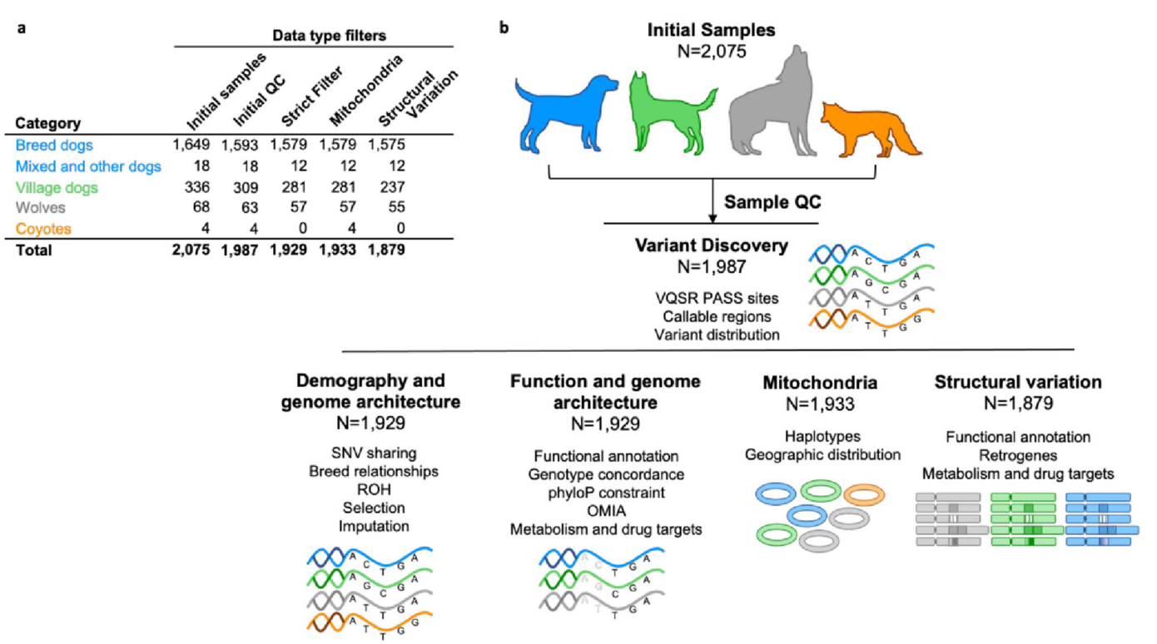
Figure 1
WGS
Illumina HiSeq
20X
150 * 150 bp
Low coverage, duplicates, missing breeds, contamination

Slide 5
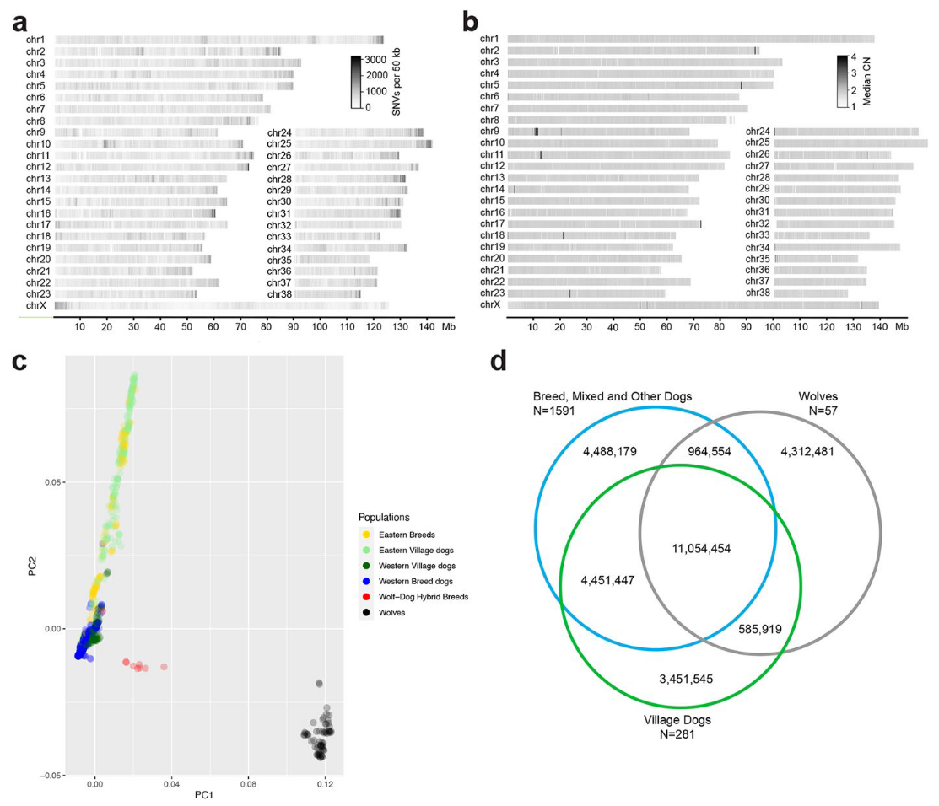
Figure 2

Slide 6
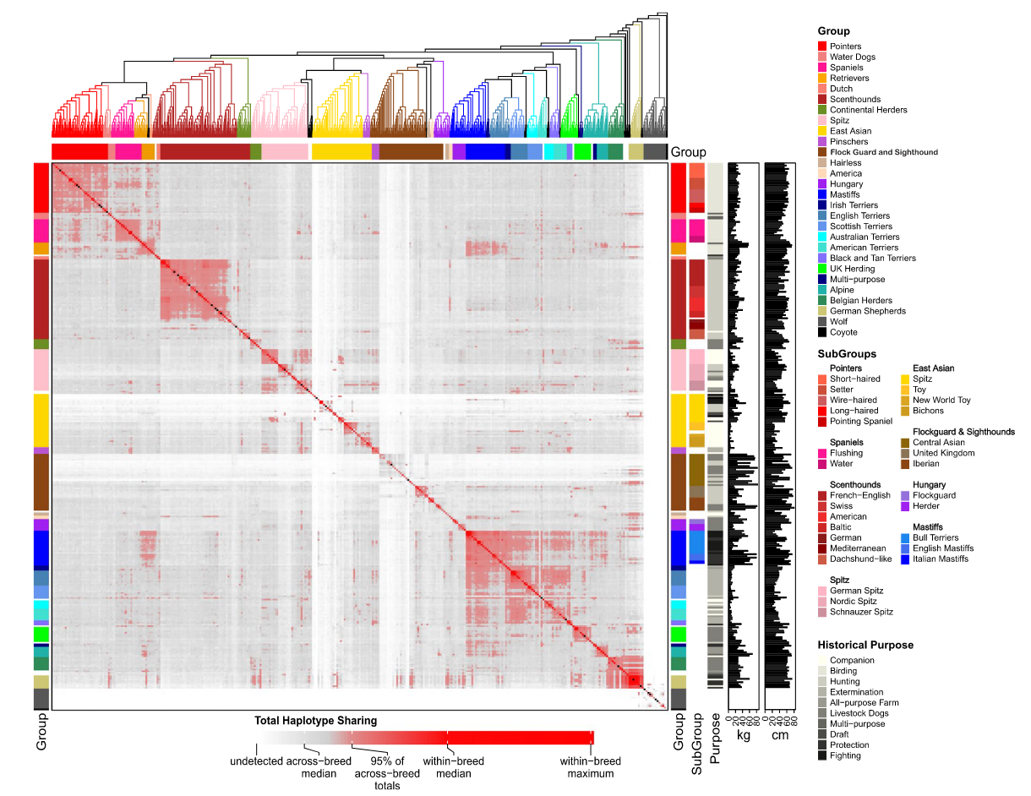
Figure 3 - Jingxuan

Slide 7
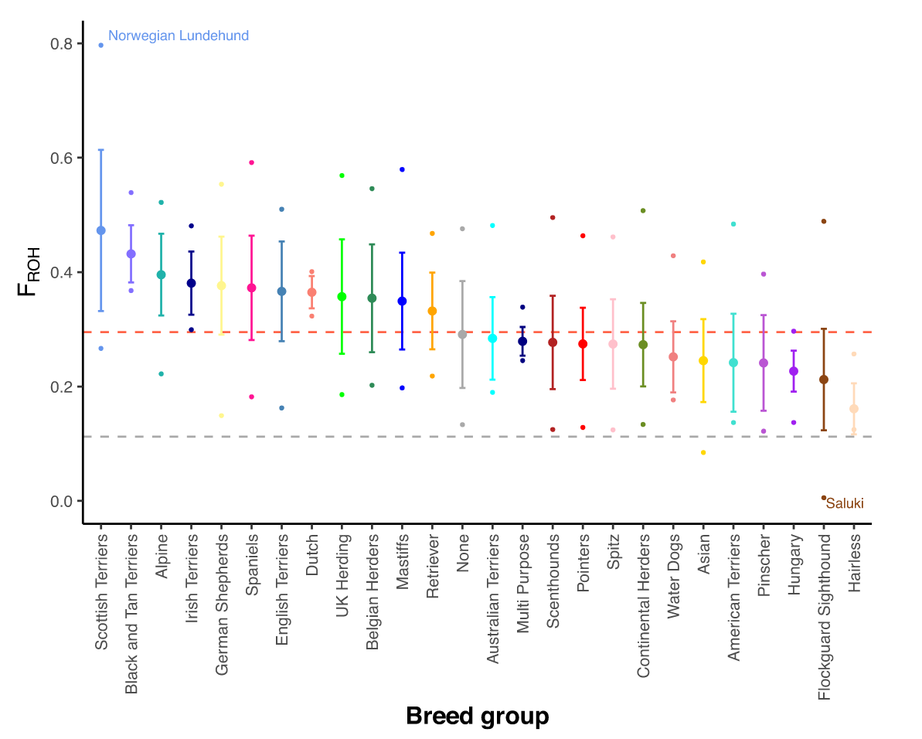
Figure 4

Slide 8
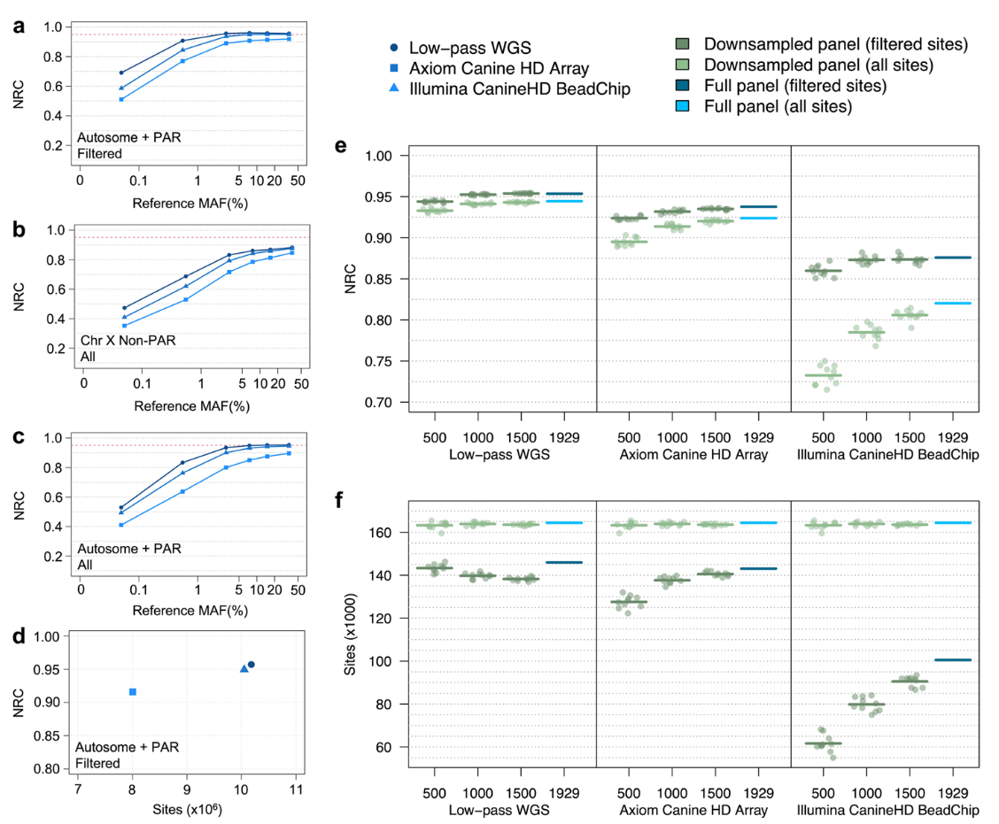
Figure 5

Slide 9
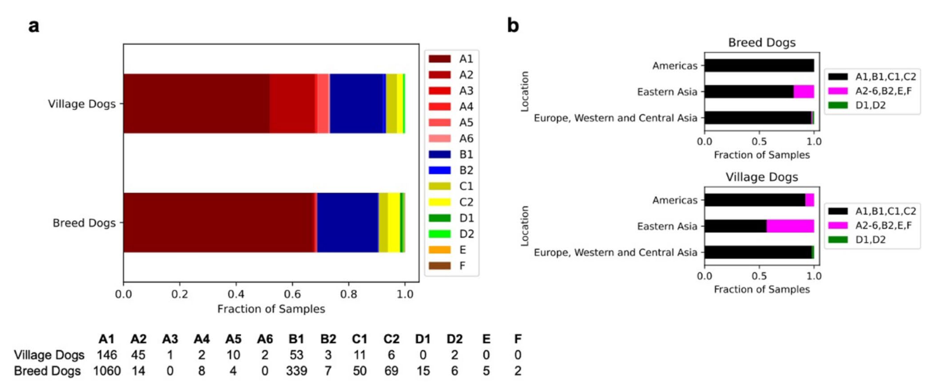
Figure 6

Slide 10
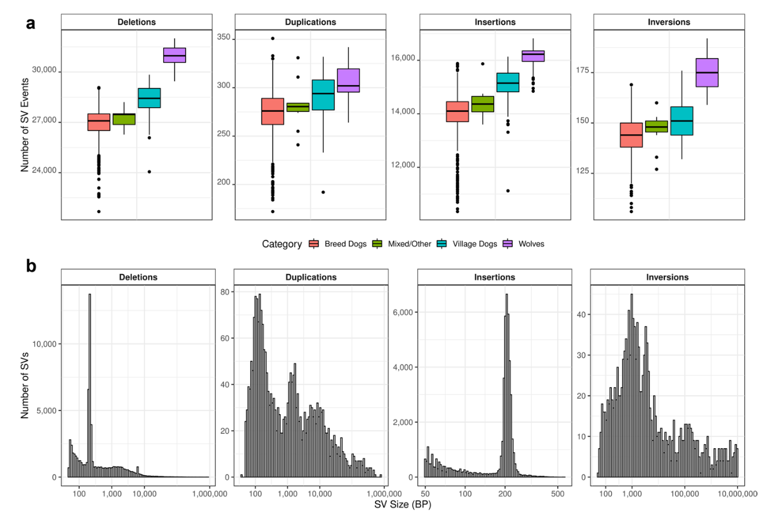
Figure 7

Slide 11
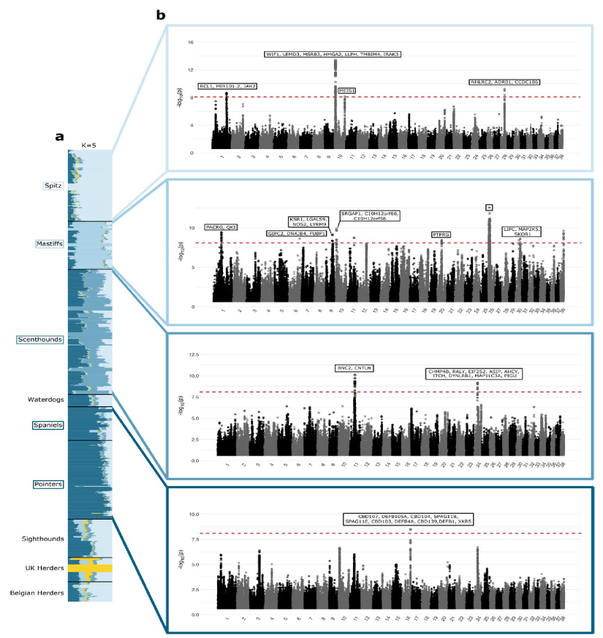
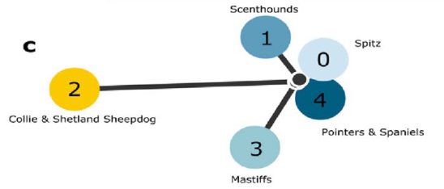
Figure 8

Slide 12
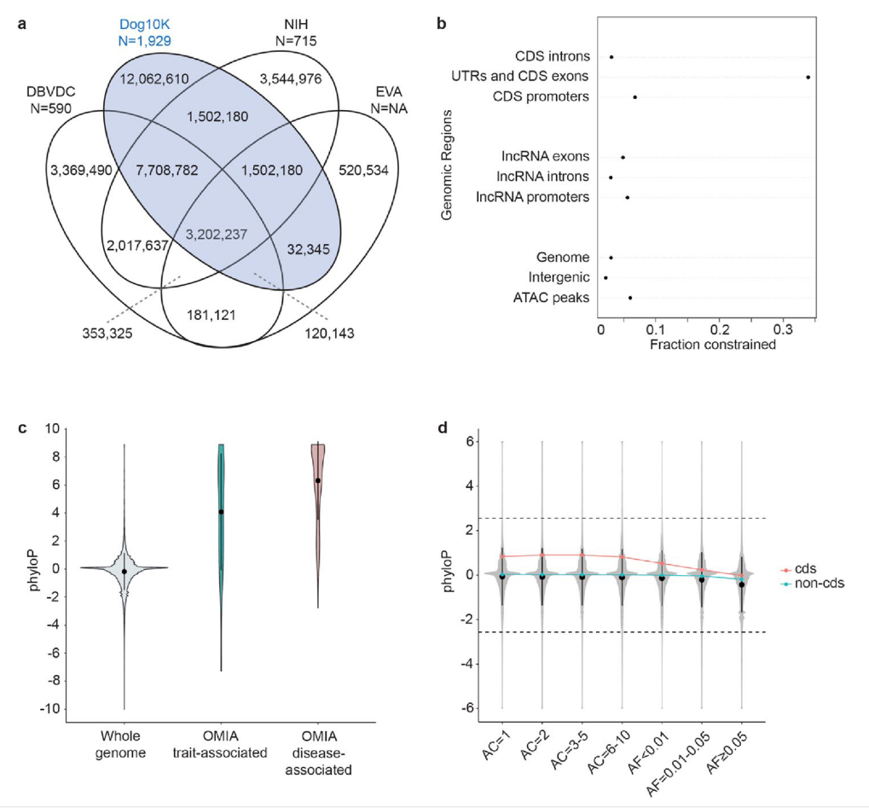
Figure 9

Slide 13
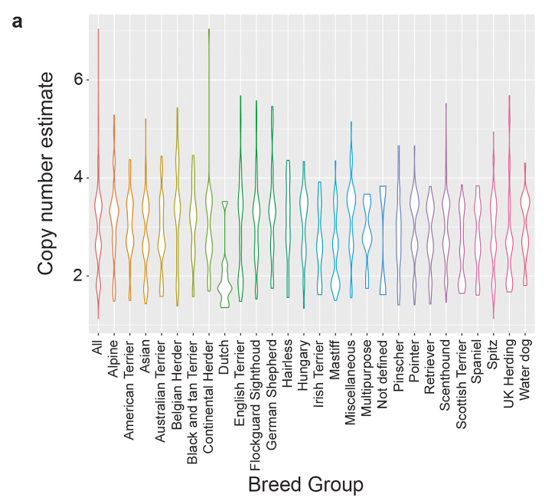
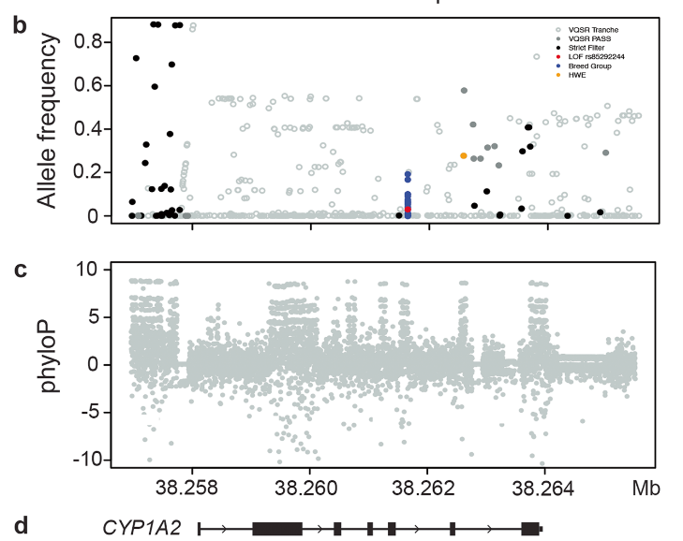
Figure 10

Slide 14
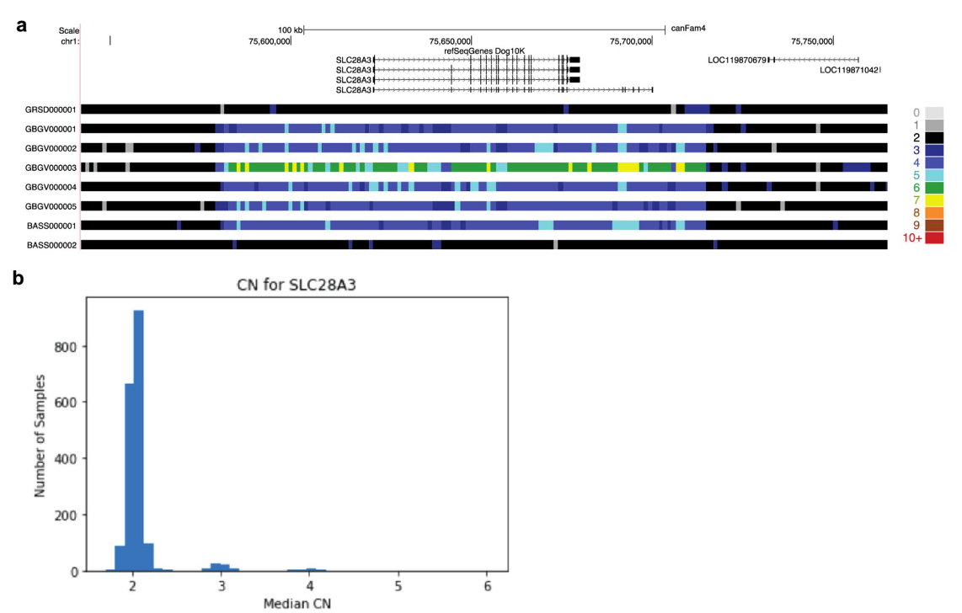
Figure 11

